Slide 1




Future topics predictor based on users tweets
Ministère de l’Enseignement supérieur et de la Recherche scientifique Université de la Manouba Ecole Nationale des Sciences de l’Informatique
Realized by :
Rahma Akaichi
Abir Bel Haj Youssef
Academic Year : 2019/2020

Slide 2


CONCEPT & Problem Setting
01
03
Pre-processing
02
PIPELINE
04
Model building & Evaluation
OVERVIEW
Conclusion & Perspects
05

Slide 3

Problem Setting and Concept
01

Slide 4


PROBLEM SETTING
At each minute about 350K tweets are generated
From users experessing their thougts and preferences about different products ,
2

Slide 5


CONCEPT
This projects aims at generating a model able to predict User’s future preferences based on their tweets,

Slide 6
PROJECT’S PIPELINE
02

Slide 7



Pipeline
Data Preprocessing
Model Buidling
Data Gathering
Word Embedding
Evaluation and prediction

Slide 8
Pre-processing
03

Slide 9
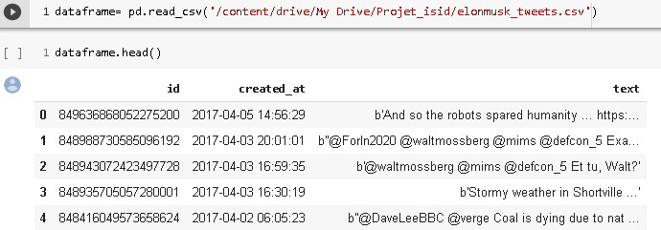
-Irrevelant Data(id)
-unstructured Data(created_at)
-lots of noise(punctuations , hyperlinks)
Initial Data:

Slide 10
Text pre-processing
Tokenization & Normalisation
I- Feature Selection
Keep the most releveant feature for the predicition(in our case Date & tweet)
Get stems from generated tokens and corresponding tag
II- Text Cleaning
Keyword Extraction & Sequence Generation
Removing stopwords , hyperlinks , punctuations , non english words,,
Get most relevant keywords Using TF-IDF and turn them into Sequences

Slide 11
Date Pre-processing

Slide 12
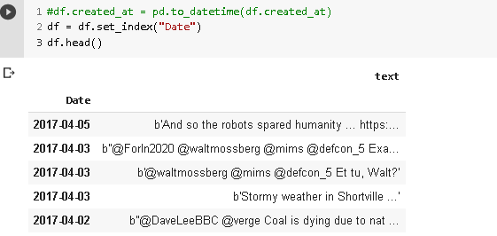
Date Preprocessing

Slide 13
Text Pre-processing

Slide 14
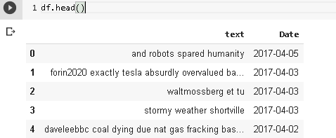
Getting meaningnful words out of the tweet

Slide 15
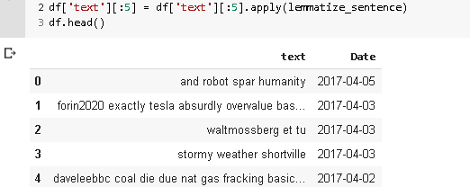
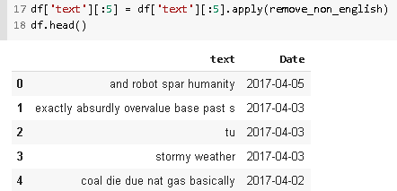
After Part of Speech Tagging and Lemmatization
After removing non English Words

Slide 16
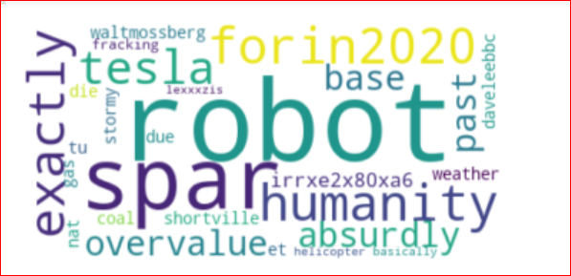
CORPUS WORDCLOUD VIZUALIZATION

Slide 17
Keywords Extraction

Slide 18
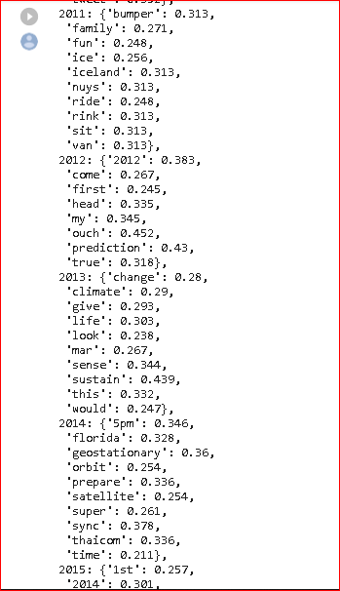
Keywords Extraction per year

Slide 19
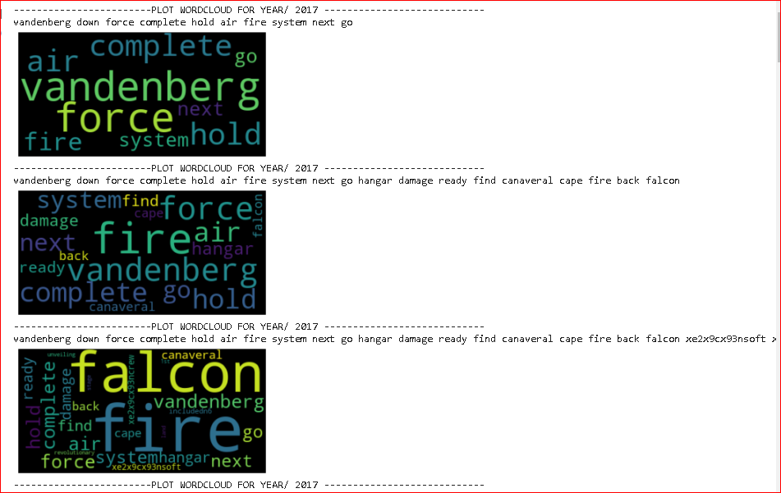
Wordcloud for keywords/year

Slide 20
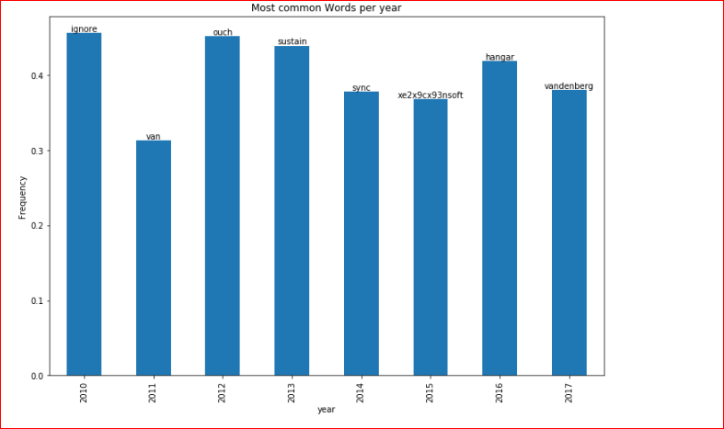
Barplot showing most common word per year

Slide 21
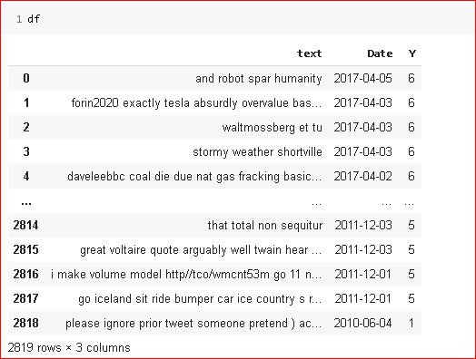
After defining the target Y and one hot encoding it

Slide 22
Dataset Splitting into train and test

Slide 23
Word Embedding

Slide 24
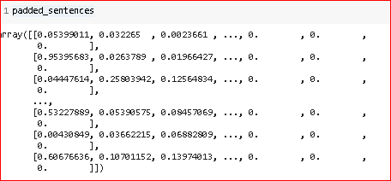
Here is the Sequence Vector Generated :

Slide 25
Model training and evaluation
04

Slide 26
Model Building

Slide 27
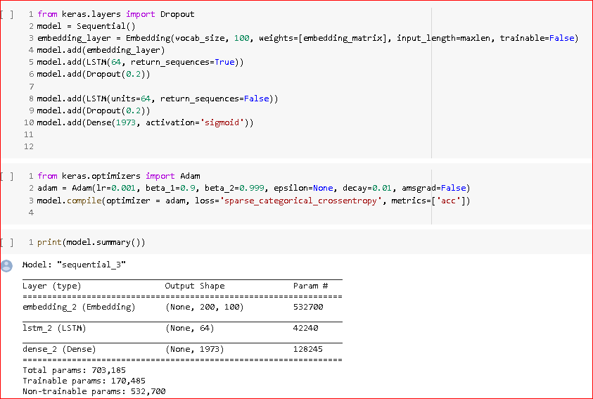
Model Building

Slide 28
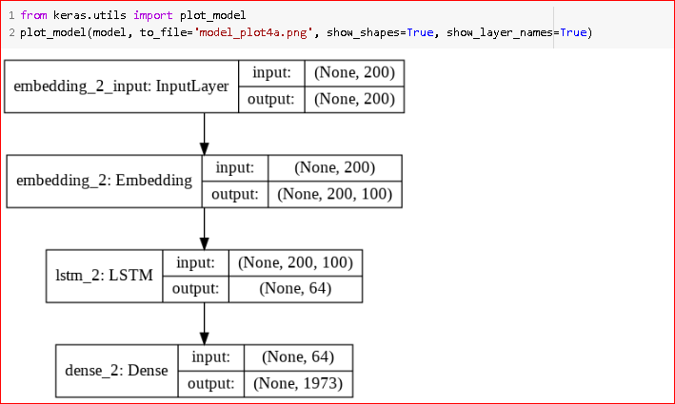
Architecture of the Network

Slide 29
Model training

Slide 30
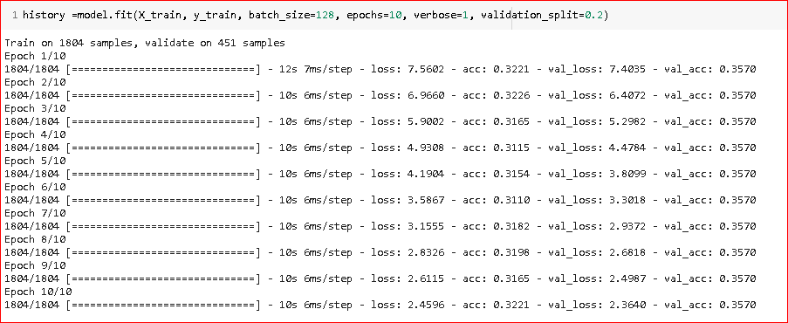
Model fitting

Slide 31
Model Evaluation

Slide 32
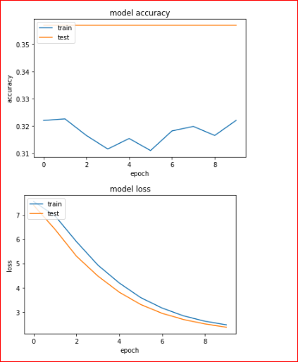
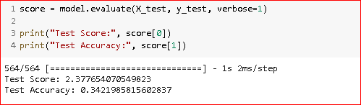
Model Evaluation

Slide 33
Conclusion & perspects
05

Slide 34

WHAT have we done so far ?
Feature Selection
Feature Engineering
Word Embedding
Model Building & Evaluation
Prediction

Slide 35

Thanks for you attention!

